Slide 1
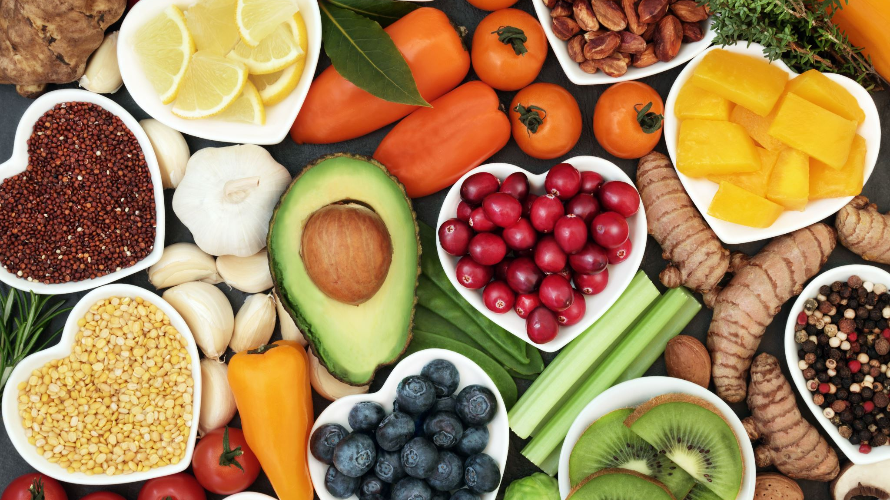
Calorie Counter
By:
Faygie Fruchthandler
Etty Tepper
Aliza Peikes
Aliza Fried

Slide 2
OUR VISION: To create a quick and user-friendly way for people to track their daily calorie intake. Science has proven that all humans need calories, or energy, to operate. However, when we consume more calories than we need, those calories get converted to fat. With our application, users can easily monitor how many calories they’ve eaten that day and how many more they can still consume. Through this, we help the users ensure that they don’t go over their daily calorie allowance.

Slide 3
User’s journey
Enter personal information
1
Choose a diet plan
2
Track calorie intake
3
Create a list of favorite foods
4

Slide 4

Personal Information User inputs basic information:
1
Enter personal information
Name
Age
Height
Weight
Gender
Standard Exercise

Slide 5
Personal Information
Once we have the user’s profile, we calculate his BMI and BMR

Slide 6
Personal Information BMR – Basel Metabolic Rate
BMR is the rate at which the body burns calories through involuntary activities.
The formula to calculate BMR varies depending on gender
Male: BMR = 66 + (6.23 * weight) + (12.7 * height) - (6.8 * age)
Female: BMR = 665 + (4.35 * weight) + (4.7 * height) - (4.7 * age)
We implement this formula using the user’s weight, height, age and gender.
We then apply the BMR to determine the amount of calories the user needs to maintain his daily activities.

Slide 7
Personal Information BMI – Body Mass Index
The BMI is derived from the body mass, or weight, and the height of a person. It determines whether a person is at a healthy weight
This is the formula: BMI= weight (lb) / [height (in)]² x 703
We implement the formula with the user’s height and weight and calculate his BMI

Slide 8
Personal Information
We then take the BMR, BMI, and standard exercise and produce a recommended diet plan.

Slide 9

Choose a Diet Plan Next, the user chooses a diet plan
2
Choose a diet plan

Slide 10
Choose a Diet Plan
The four diet options
Weight Gain
Maintenance
Weight Loss
Extreme Weight Loss

Slide 11
Choose a Diet Plan
Based on the user’s profile, we tell him which diet we recommend and how many daily calories it allows.
The user, however, can choose to go ahead with any of the other diet options.
Once the user chooses, we set his daily calorie goal

Slide 12
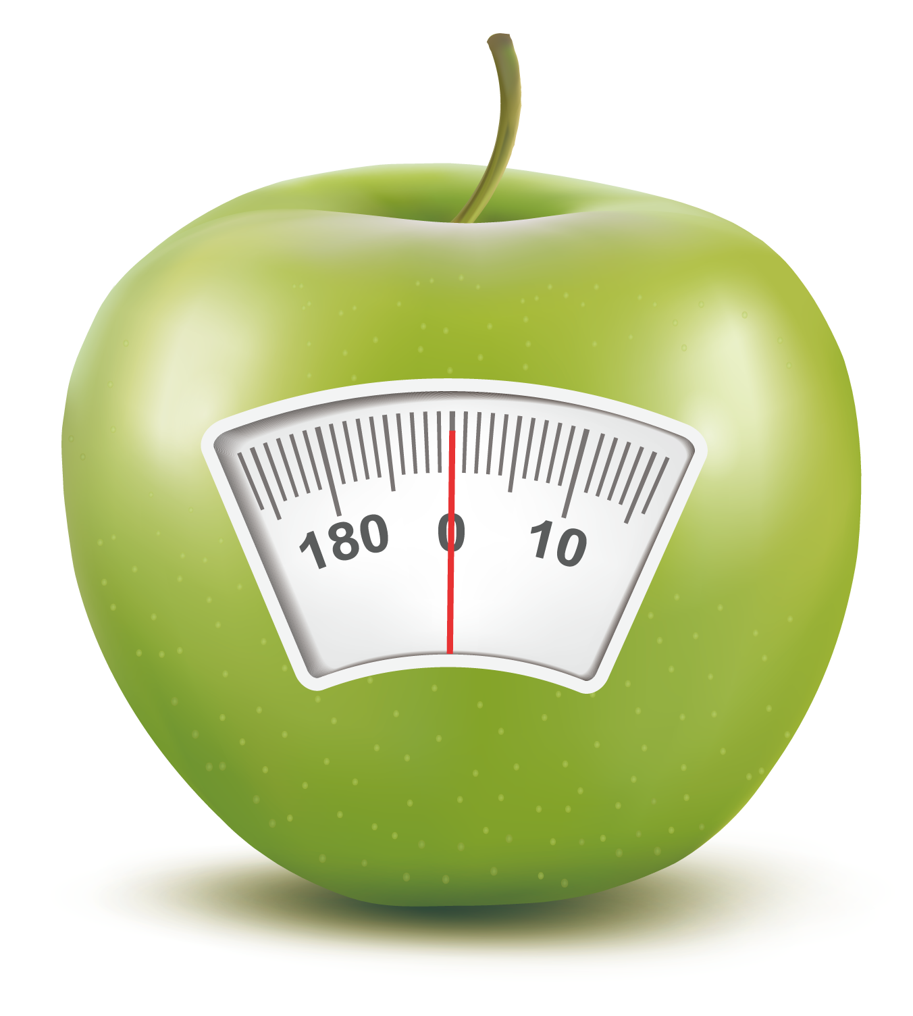
Track Calorie Intake Now the user can start tracking his calorie intake
3
Track calorie intake
Options
Add Calorie Intake
Check Calorie Count

Slide 13
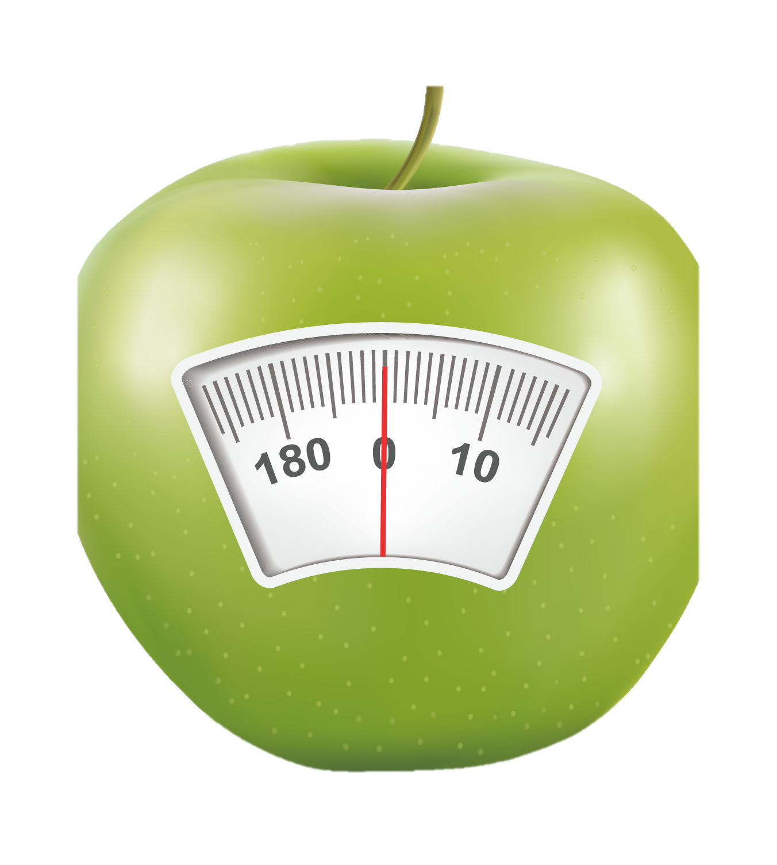
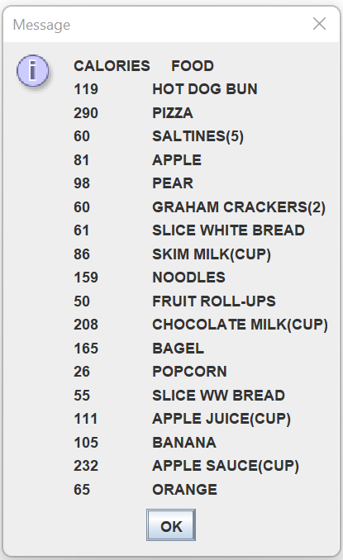
Track Calorie Intake Add Calorie Intake
To add intake calories the user can either
Add the explicit calorie amount
Add a specific food from a list of common foods. The app will add that food’s corresponding calories to the overall count

Slide 14
Track Calorie Intake Add Calorie Intake
!
As the user nears his calorie goal, the app will alert him and tell him how many calories he has left to consume. If the user exceeds his goal, the app will warn him as well.

Slide 15
Track Calorie Intake Check Calorie Count
The user can also check his current calorie count. If he is close to his goal, the program will tell him so and how much he has left.
Since the calorie goal is per day, the current calorie count resets each day at 12:00 AM.

Slide 16

Add Favorite Foods to List
4
Create a list of favorite foods
An additional feature of our program is that users can enter their favorite foods with the calorie amount to the food list.

Slide 17
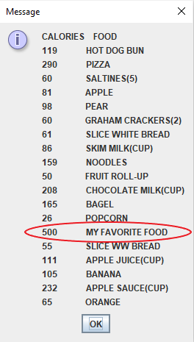
Add Favorite Foods To List
Once the food is entered, it gets added to the food list for easy access.
Next time the user eats this food, he can just type in the food name and that calorie amount will be added.

Slide 18

Feedback
Thank you for listening
We would love to hear your feedback at:
feedback@caloriecounter.com

